Slide 1
TITLE OF THE PROJECT
A FICTIONAL MUSIC DATABASE USING SQL

Slide 2
OBJECTIVE
The aim of this project is to analyze the best city, top country for events, popular music genres by country using the tool MYSQL for best data driven summarizing insights.

Slide 3
TOOLS AND TECHNOLOGIES
MY-SQL WORKBENCH to write and understand the code for each levels.
MICROSOFT EXCEL for extracting the data-sets.

Slide 4
DATASETS USED
The tables we used are as follows:
Employee Table: Contains details of employees, including their job title and seniority levels.
Invoice Table: Contains all invoices with billing information.
Invoice line Table: Detailed information on each item within an invoice.
Customer Table: Contains customer data, such as first and last names and contact
information.
Track Table: Details of each track, including genre and duration.
Album Table: Contains information on music albums.
Artist Table: Information on different artist id and names.
Genre Table: Information on genre’s
Each Table contains Relevant information and important fields like
Customer_id, Invoice_id,Track_id,Album_id and Artist_id

Slide 5
METHODOLOGY/WORKFLOW
Data extraction from Microsoft Excel CSV file and import in MYSQL Workbench.
Data Transformation is done by creating database and using that data base for writing the code.
Insights generation is done with SQL Query Optimization.

Slide 6
FEATURES OF DIFFERENT LEVEL QUERRIES

Slide 7
EASY LEVEL QUERRIES

Slide 8
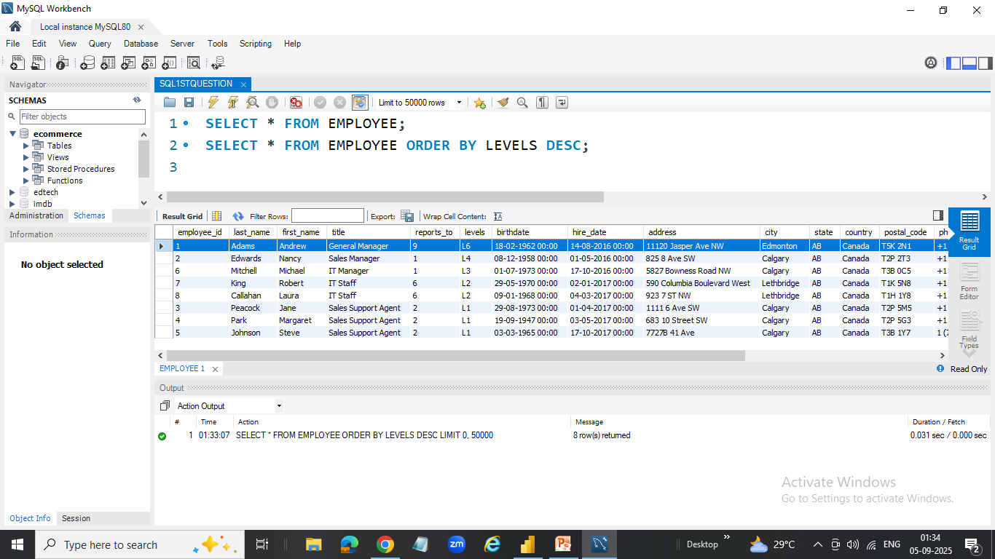
Q1: Find the most senior employee based on job title.
Andrew Adams is the employee whose Job Title is “General Manager” whose Levels is “L6” who is the most senior employee.
Notes:
Andrew Adams is the employee whose Job Title is “General Manager” whose Levels is “L6” who is the most senior employee.

Slide 9
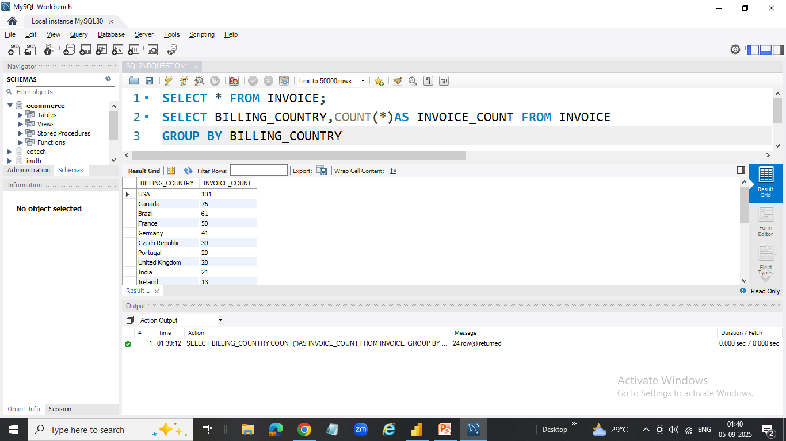
Q2: Determine which countries have the most invoices.
USA is the top Billing Country having invoice count 131
Notes:
Andrew Adams is the employee whose Job Title is “General Manager” whose Levels is “L6” who is the most senior employee.

Slide 10
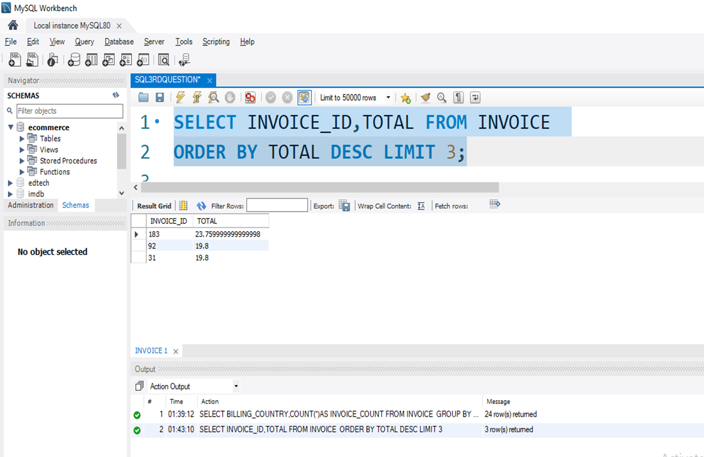
Q3: Identify the top 3 invoice totals.
Invoice Id 183,92,31 have the highest invoice totals

Slide 11
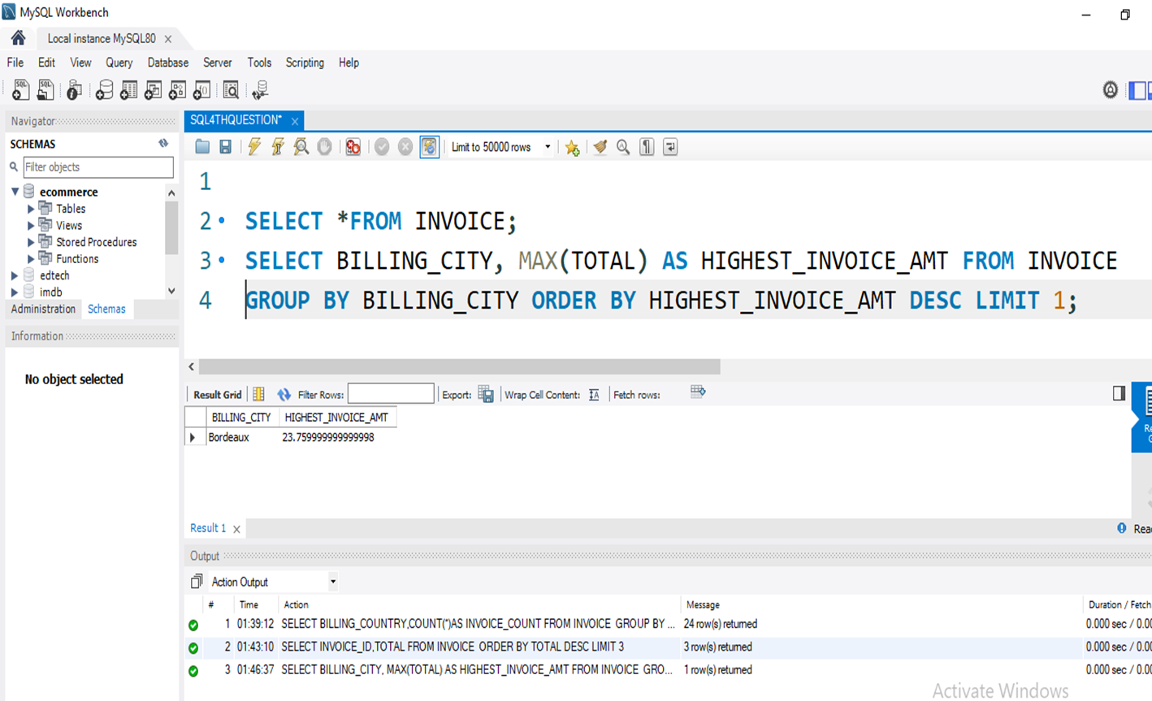
Q4: Find the city with the highest total invoice amount to determine the best location for a promotional event.
BORDEAUX is the city having highest invoice amount

Slide 12
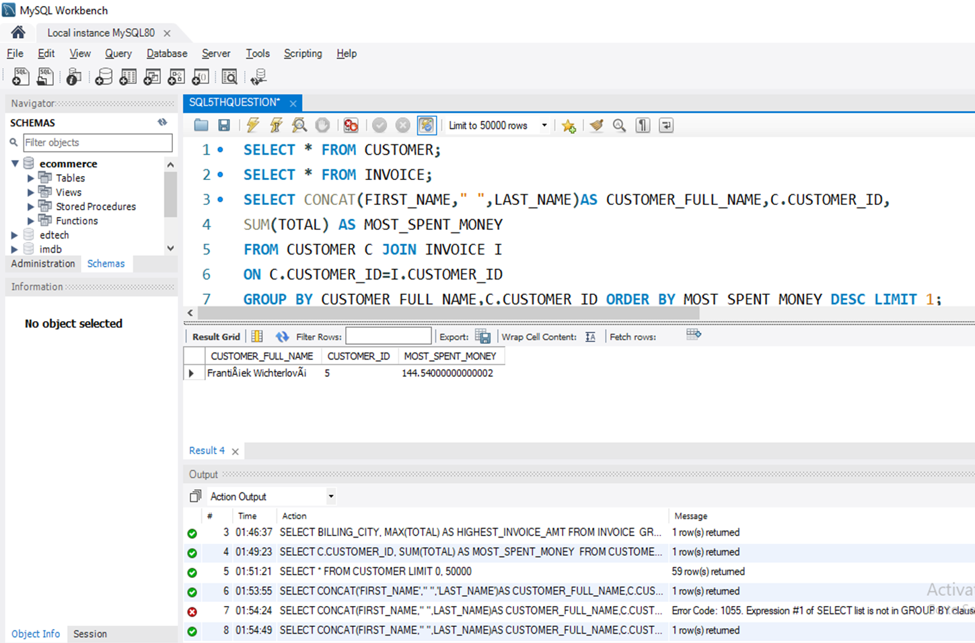
Q5: Identify the customer who has spent the most money.
FrantiÅ¡ek WichterlovÃ¡ is the customer who has spent the most money.

Slide 13
MODERATE LEVEL QUERIES

Slide 14
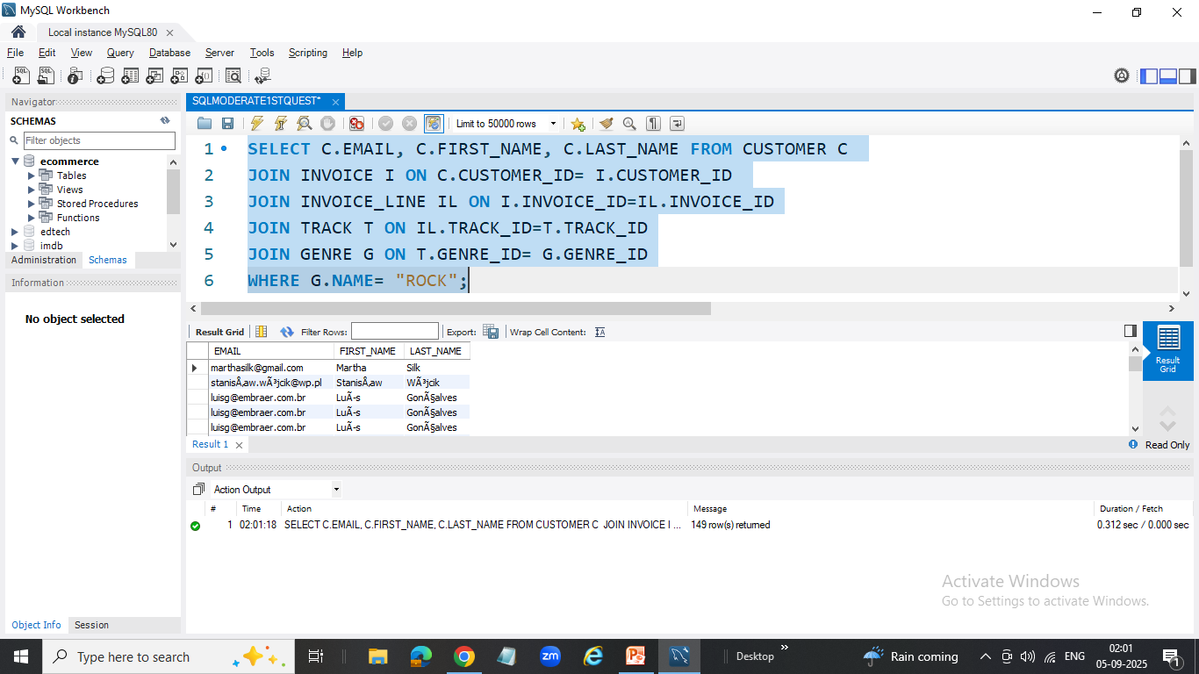
Q1: Find the email, first name, and last name of customers who listen to Rock music.
By using joining tables between customer,invoice,invoice line,track and genere we got those customers who listen to Rock music by 149rows.

Slide 15
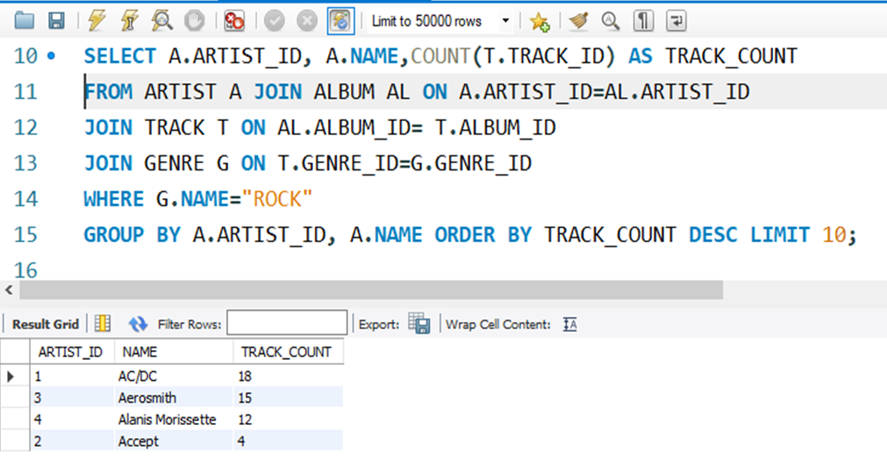
Q2: Identify the top 10 rock artists based on track count.
For that music genre-Rock we can find only Top 4 artists based on Track count

Slide 16
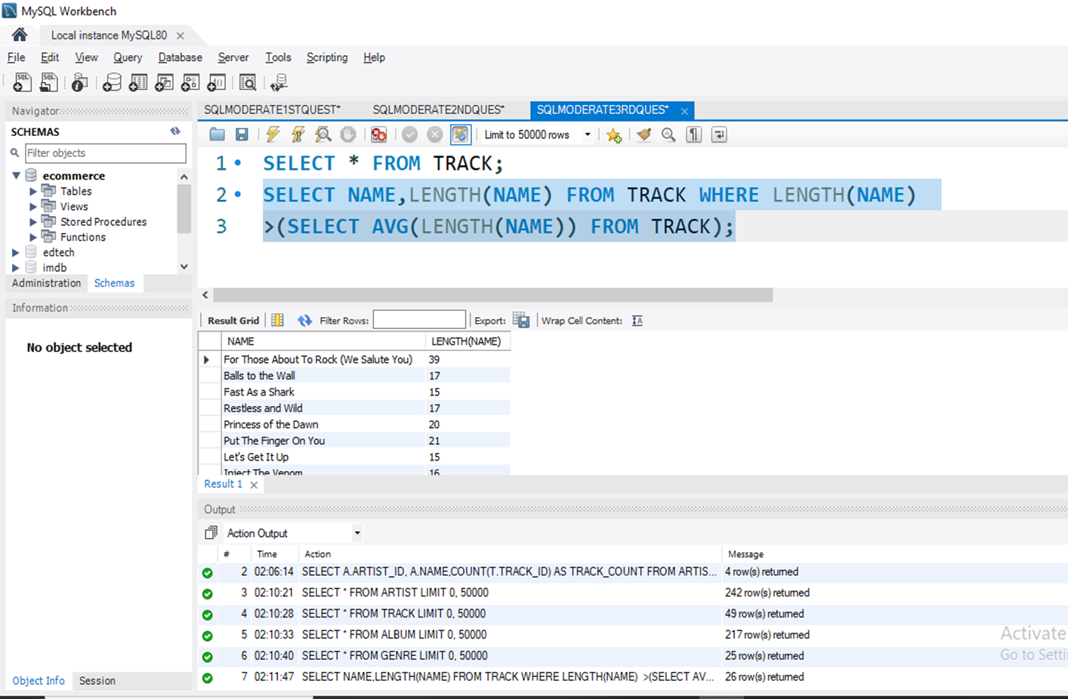
Q3: Find all track names that are longer than the average track length.
So there are 26 names with track names longer than the average track length names.

Slide 17
ADVANCED LEVEL QUERIES

Slide 18
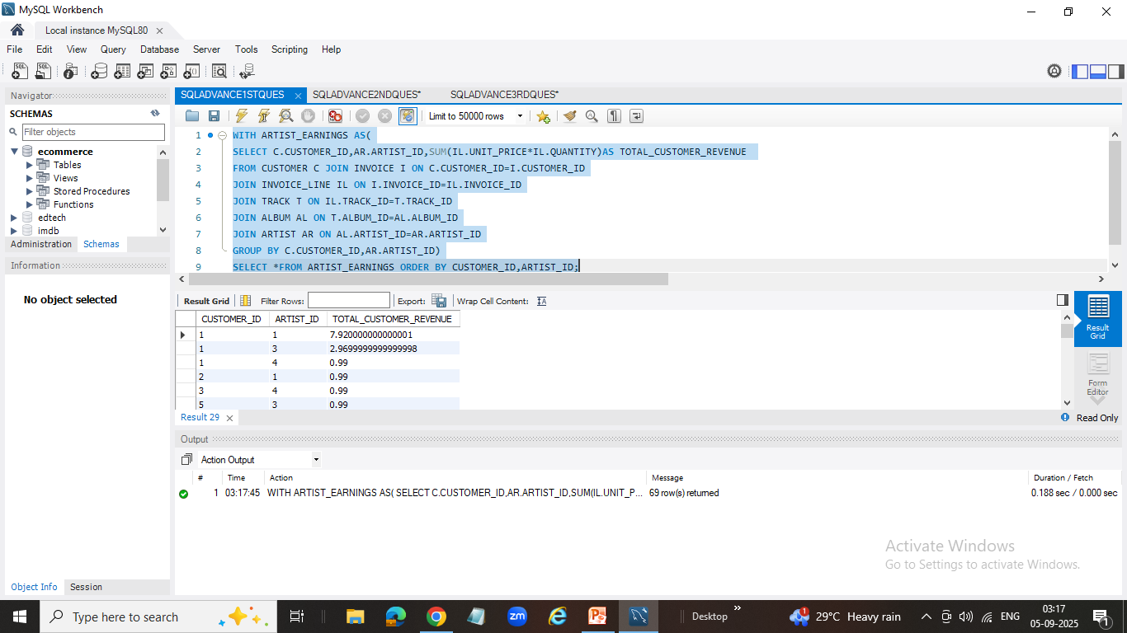
Q1: Calculate how much each customer has spent on each artist.
In this we can see how each customer has spent on each artist what is the revenue generated.

Slide 19
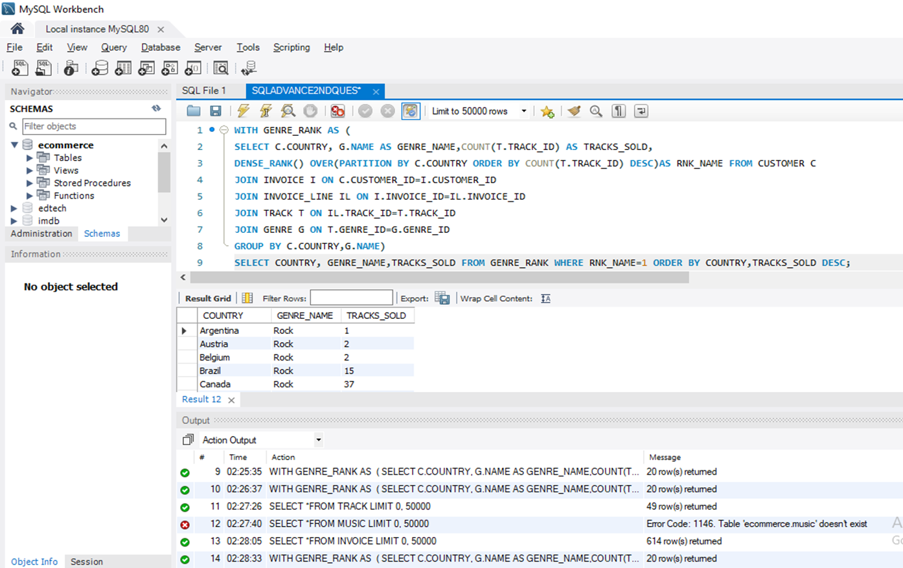
Q2: Determine the most popular music genre for each country based on purchases.
Almost all the countries holds Rock genre as the top genre.

Slide 20
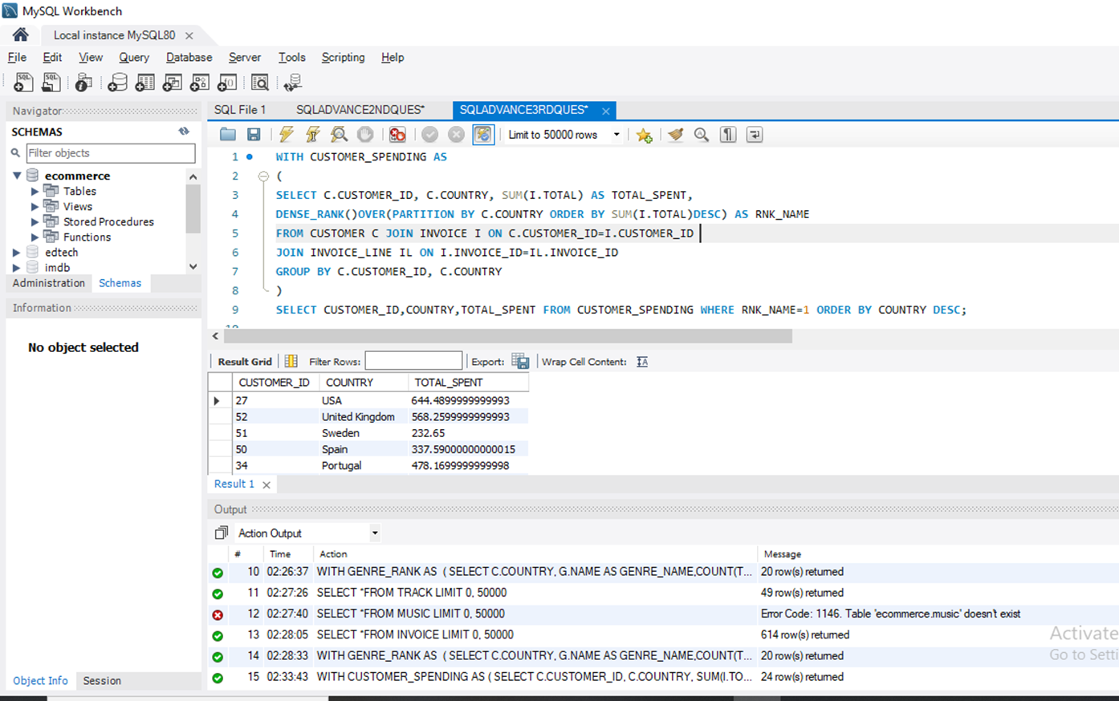
. Q3: Identify the top-spending customer for each country
Customer ID 27 of country USA is the top spending customer

Slide 21
RESULTS
The main key insight we can say is among all the invoice billing countries, customers from “USA” top with invoice spending money.
And also we can see that most of the customers prefer Music Genre “ROCK” as their priority.

Slide 22
CHALLENGES FACED
The most crucial part of SQL is using JOINS across different tables.
In this project there were the scenario in advanced level queries to join 5 tables to filter the data and get over the problem statement.

Slide 23
CONCLUSION
The project was overall very useful and thoughtful process where we used many joining techniques, windows functions to rank the genres etc,
also putting some logic for advanced queries is the most learning part.

Slide 24
LINK FOR PROJECT
GITHUB LINK

